Slide 1
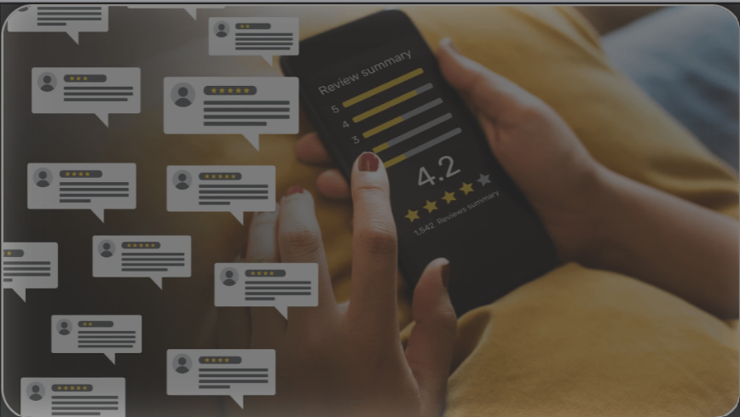
Restaurant Review Website
Team 1
MENUMATCH

Slide 2
Team Members
Team Leader - Dirgha Jivani.
Requirement Leader - Roshni Dodhi.
Design and Implementation Leader - Anshul Raj.
Configuration Leader - Vignesh S.
Security Leader - Prayushi Khandelwal.
QA Leader - Jiho Cheon.
Design and Implementation Leader. - Pratyush Patel

Slide 3
Table of Content
Summary : Progress,Challenges and Insights.
Functional Requirements Update.
Non Functional Requirements.
Configuration Management and CI/CD.
Risk Management.
Demo and Video Presentation.
Next steps.

Slide 4
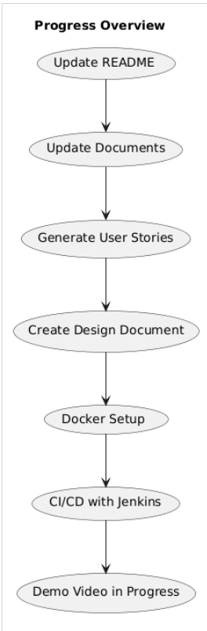
Summary: Progress, Challenges, and Insights
README.md, project document, meeting minutes, and progress report updates.
User stories generated, Software Design Document (SDD) created.
Iteration 1 presentation completed.
Source code is runnable with Dockerfiles and the starter code merged.
Jenkinsfile updated for CI/CD integration.
Project demo video is in progress.
Notes:
“In this iteration, we focused on foundational tasks to set up our project. We updated our README and all project documentation, including meeting minutes and progress reports. User stories were generated, and we created a Software Design Document (SDD) to outline the system architecture and design elements.
We made the source code runnable by integrating Dockerfiles and merging the starter code. CI/CD integration was initiated by updating the Jenkinsfile, which will streamline our deployment process.

Slide 5
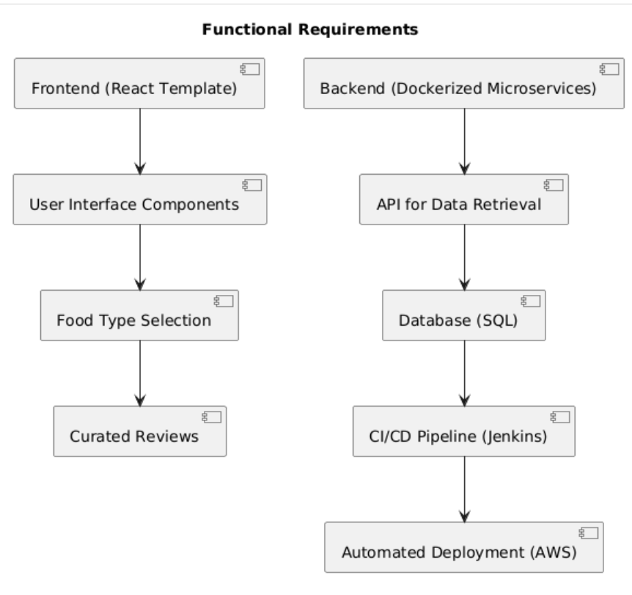
Functional Requirements Update
Essential Features:
Added starter code for the core platform functionality
Dockerfiles incorporated for easy setup and deployment
React template added to begin UI development for food type selection and curated reviews
Jenkinsfile updated for automated deployment
Updated mobile and web accessibility
Desirable Features:
Planning on adding nationality input function for users.
Optional Features:
Planning for future inclusion of food photo uploads.
Notes:
“This slide covers the functional requirements of our platform. Key features include a React template for the frontend, which allows users to select food types and view curated reviews.
Dockerfiles were added to facilitate deployment, and the Jenkinsfile enables automated deployment and testing. We prioritized mobile and web accessibility to ensure a user-friendly experience across devices.
Looking forward, we’re planning to add nationality input as a desirable feature. Additionally, photo uploads are on our radar as an optional feature for future development.”

Slide 6
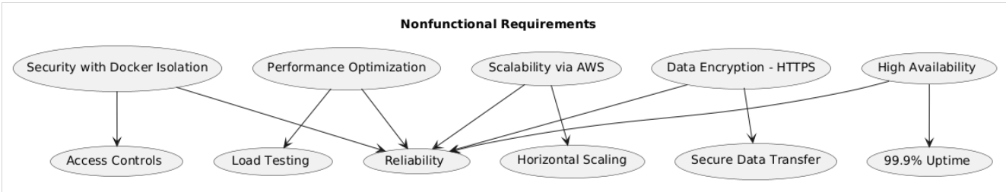
Nonfunctional Requirements
Security:
Docker for secure, isolated environments, Jenkins pipeline setup, AWS connection, data encryption.
Performance:
React for faster UI, Docker for consistent deployment, testing concurrent users on AWS.
Scalability:
Docker for containerization, AWS and Jenkins for CI/CD.
Notes:
“To enhance the platform's security, we utilized Docker for isolated environments and integrated data encryption with HTTPS protocols. The Jenkins pipeline is currently being set up to automate security checks and deployment on AWS.
From a performance standpoint, we integrated React for a smoother UI experience, and Docker ensures consistent deployment across various environments. We also conducted testing with concurrent users on AWS.
For scalability, Docker supports containerization while AWS and Jenkins ensure smooth CI/CD for continuous deployment and scaling.”

Slide 7
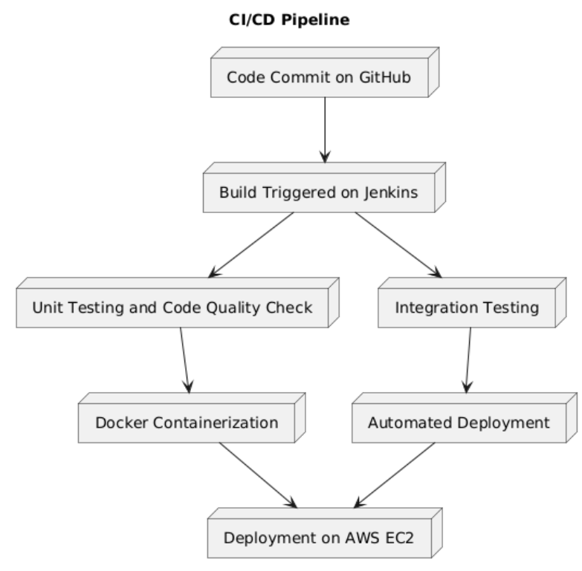
Configuration Management and CI/CD
Tools and Setup:
JIRA used for task management
GitHub for version control
Merge pull request #4 completed for starter code
AWS and Jenkins for CI/CD setup
Jenkinsfile integrated for automated deployment
Updated with Dockerfiles to streamline setup and testing
Docker files added for the project to support containerization and easy deployment across environments
Notes:
For our project setup, we have utilized a set of tools to ensure seamless collaboration, version control, and deployment.
We started with jira, which we used for effective task management, tracking progress, and ensuring that all team members stay aligned with our project goals.
We implemented GitHub for version control, which allowed us to manage our codebase efficiently. I'm pleased to share that we successfully completed Merge pull request #4, which included the starter code for the project.
For continuous integration and deployment, we set up AWS and Jenkins. This combination helps automate the build and deployment processes, ensuring that any code changes are smoothly integrated and tested.
To make our deployments even more efficient, we integrated a Jenkinsfile, which automates the steps involved in our deployment pipeline.
We also focused on containerization by adding Dockerfiles to the project. This approach allows us to streamline setup and testing, ensuring that our application can be easily deployed across different environments.
Overall, these tools have helped us maintain a streamlined development process, enabling faster iterations, consistent deployments, and improved team collaboration.

Slide 8
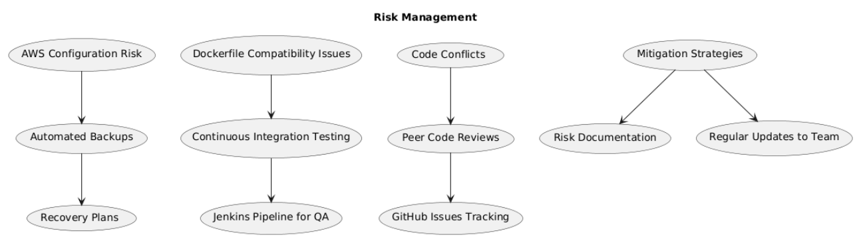
Risk Management
Risks identified:
Managing AWS and Jenkins pipeline configurations
Ensuring Dockerfile and Jenkinsfile compatibility
Merging and resolving code conflicts during pull requests
Mitigation plans:
Continuous testing of Docker environments with Jenkins integration
Using GitHub Issues to track and manage bugs
Conducting peer code reviews before merging pull requests
Notes:
There were three risk identified and three according mitigation plans:
To start with the risks, In our project, we use AWS and Jenkins to automate deployment and continuous integration. A major risk here is the complexity of managing these configurations correctly.
Another challenge arises in making sure the Dockerfile and Jenkinsfile are compatible. Any inconsistency here might break the build or prevent the environment from being correctly set up.
Lastly, merging changes in a collaborative project often leads to code conflicts. If these conflicts aren’t handled properly, it could cause delays or introduce bugs.
Now our plans are,
To mitigate configuration issues, we’ll run continuous tests on our Docker environments and integrate them with Jenkins. This approach ensures that any problem in the setup is detected early in the pipeline, allowing us to address it before it impacts the main codebase or deployment process.
Also, for better visibility of bugs and risks, we’ll use GitHub Issues. This will help us track any problems in real time, assign tasks to team members, and ensure timely resolution. By keeping a clear record of issues, we reduce the risk of unresolved bugs affecting future development.
Finally, to address code conflicts and improve code quality, we’ll conduct peer code reviews before merging any pull requests. This helps ensure that conflicts are spotted early, and the code is optimized for performance and reliability. It also facilitates collaboration and knowledge sharing among team members.
We identified several risks, including AWS and Jenkins pipeline configurations, Dockerfile and Jenkinsfile compatibility, and code conflicts during pull requests.
To mitigate these risks, we’re conducting continuous testing with Jenkins and tracking issues on GitHub. Peer code reviews are done before any merges to reduce errors and ensure quality.

Slide 9
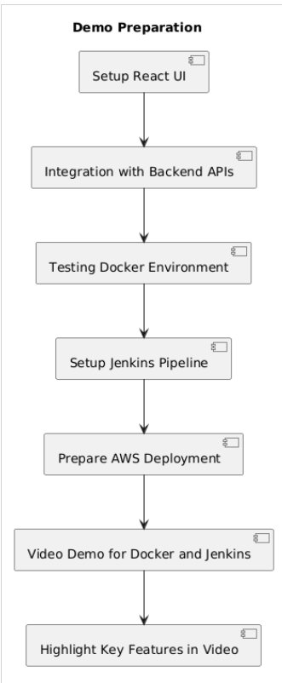
Demo and Video Preparation
Demo:
Demonstrating starter code with Docker and React template, Jenkins pipeline.
Project Video:
Focus on Docker setup, Jenkins integration, starter code.
Notes:
In the demo, we will showcase the Docker setup and React template integration with our backend. The Jenkins pipeline for AWS deployment will also be demonstrated.
The project video is being prepared and will feature a walkthrough of our Docker and Jenkins setup, along with an overview of the starter code functionality.

Slide 10
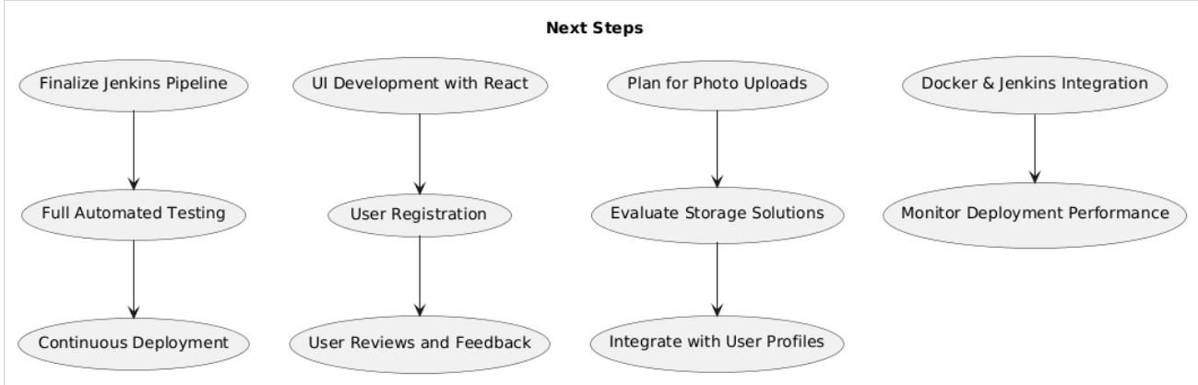
Next Steps
Upcoming Focus:
Finalize Jenkins pipeline, continue React UI development, photo uploads, Docker/Jenkins integration.
Notes:
Our immediate focus is finalizing the Jenkins pipeline for automated deployment and testing. We plan to expand the UI with React, enabling user registration and reviews.
In the longer term, we’re considering additional features like photo uploads and flavor descriptions to enhance user engagement. We aim to refine Dockerfile and Jenkinsfile integration for continuous deployment, ensuring the platform remains stable and scalable.

